Slide 1
TCP-Adaptive Reno for Improving Efficiency-Friendliness Trade-offs of TCP Congestion Control Algorithm
Md. Nazmul Islam Ananto
1805093

Slide 2
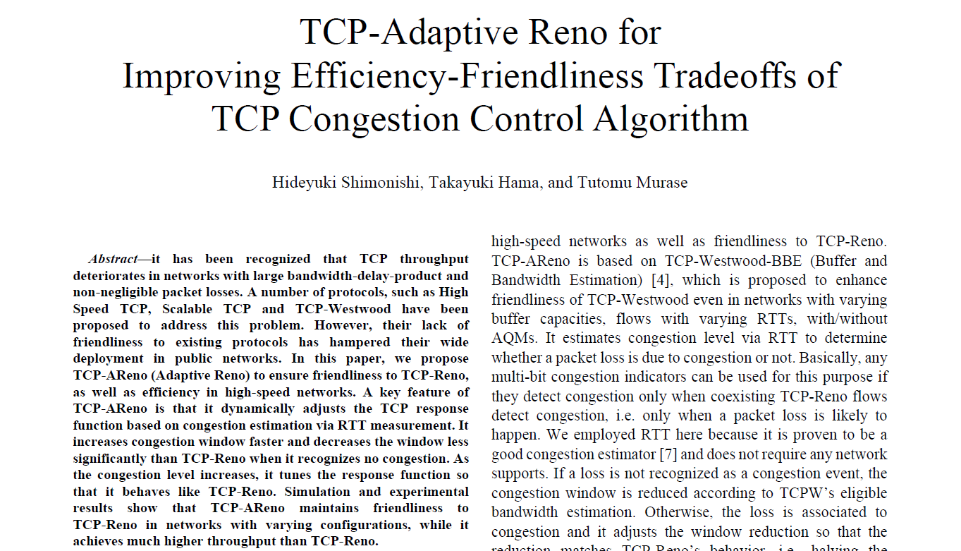

Slide 3
Why TCP Adaptive Reno?
Disadvantage of TCP Reno
Unfriendliness of other alternatives

Slide 4
Why Adaptive Reno?
The widely used congestion control algorithm TCP-Reno has some disadvantages. Its’ throughput decreases in networks with large bandwidth delay product and with non negligible packet loss.

Slide 5
Why Adaptive Reno?
Other congestion control algorithms like TCP-Westwood / TCPHighSpeed attempts to solve this problem but their potential unfriendliness to TCPReno is one of the reasons hampering their deployment.

Slide 6
Proposed Algorithm
Overview

Slide 7
What it does
Estimates congestion level via RTT to determine whether a packet loss is due to congestion or not.
Introduces a fast window expansion mechanism to quickly increase congestion window whenever it finds network underutilization. The congestion window increase will have 2 parts: The base part increases linearly in congestion avoidance phase just like TCP-Reno whereas the probe part increase exponentially to utilize the network fully.
Adjusts congestion window reduction based on the congestion measurement. Congestion window is halved when the network is congested and a packet loss is likely to happen, while the reduction is mitigated when the network is underutilized.

Slide 8
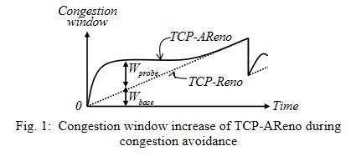
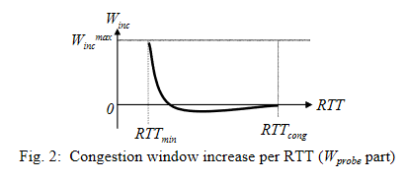
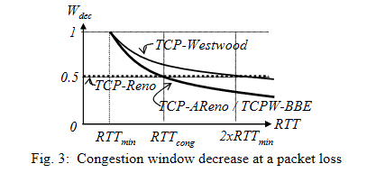

Slide 9
Claim
The paper claims the TCP-AReno modifications results in:
• Higher throughput than TCP-Reno.
• Friendlier to TCP-Reno over a wide range of link capacities and random packet loss rates.

Slide 10
Thank you
Md. Nazmul Islam Ananto
1805093

